Slide 1
Weapon Object Detection Using Quantized YOLOv8
Aahil Halani
20k-0308
Faizan Hakim
20k-0290

Slide 2
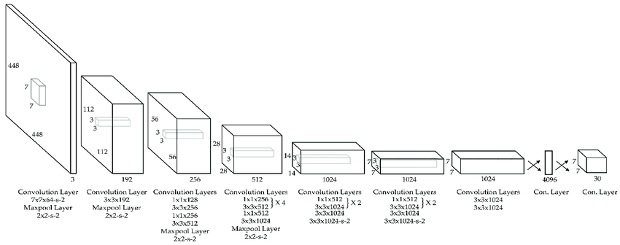
YOLO Architecture

Slide 3
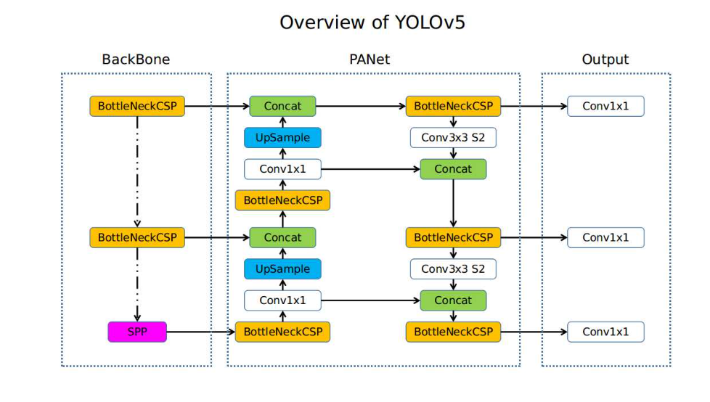
YOLO v5 Architecture

Slide 4
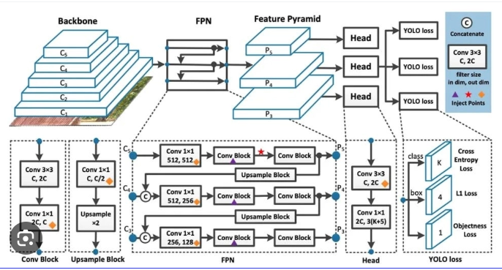
YOLO v8 Architecture

Slide 5
YOLO V8
YOLO v8 is the latest version of the acclaimed real-time object detection and image segmentation model.
It is built on cutting-edge advancements in deep learning and computer vision, offering unparalleled performance in terms of speed and accuracy.
Its streamlined design makes it suitable for various applications and easily adaptable to different hardware platforms, from edge devices to cloud APIs.

Slide 6
YOLO V8 vs YOLO Previous Versions
Faster Detection Speed
More Accurate
Preferable for real time object detection

Slide 7
Dataset
8425 photos of weapons collected from Roboflow
70% of the data is used for training purposes
20% is used for validation
10% is used for testing

Slide 8
Augmentation
Flip: Horizontal
90° Rotate: Clockwise, Counter-Clockwise, Upside Down
Blur: Up to 2.5px

Slide 9
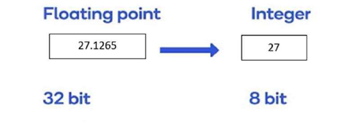
Quantization
Lowering the precision of the weights, biases, and activations to minimize their memory requirements.
It entails converting a neural network, which usually represents parameters with 32-bit floats, to a smaller representation like 8-bit integers.(Reduced by a factor of 4)
Reduces memory consumption.
Lowers network latency and enhancing power efficiency.

Slide 10
Quantization Drawback
It may affect the accuracy of neural networks.
Quantization alters how information is represented in the network.
However, research has shown that the loss of accuracy due to quantization is often negligible compared to the gains in latency reduction, memory savings, and energy efficiency.
The extent to which accuracy is affected depends on the level of precision loss, the architecture of the network, and the specific training and quantization techniques used.

Slide 11
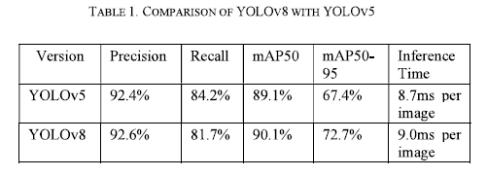
YOLO v5 VS YOLO v8

Slide 12
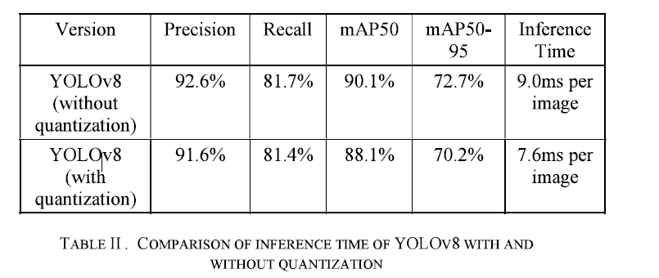
Performance Comparison with and without Quantization (In the Research Paper)

Slide 13
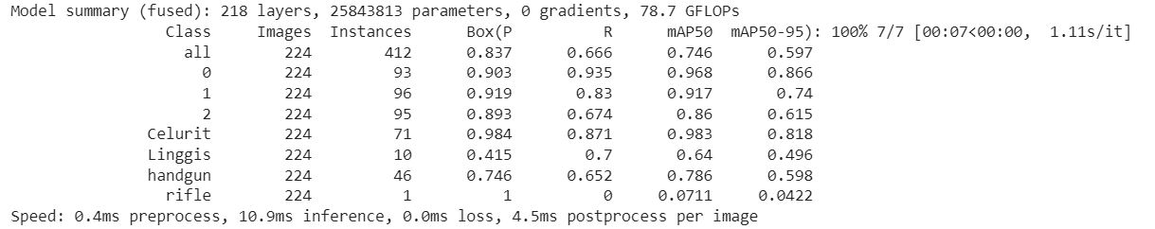
YOLO v8 Model Summary

Slide 14
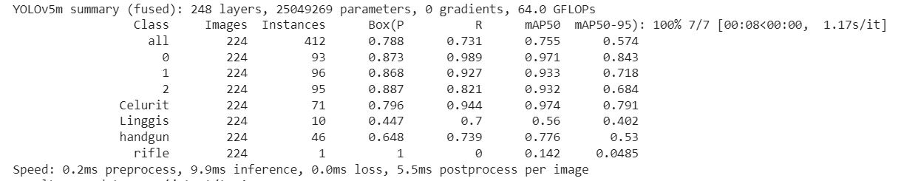
YOLO v5 Model Summary

Slide 15
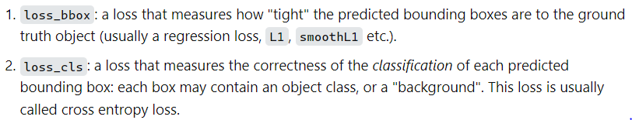
Loss Functions

Slide 16
YOLO v5 VS YOLO v8 Performance without Quantization
Version | Precision | Recall | mAP50 | mAP50-95 | Inference Time
YOLO v5 | 79.6% | 94.4% | 97.4% | 79.1% | 9.9ms
YOLO v8 | 98.4% | 87.1% | 98.3% | 81.8% | 10.9ms

